Slide 1
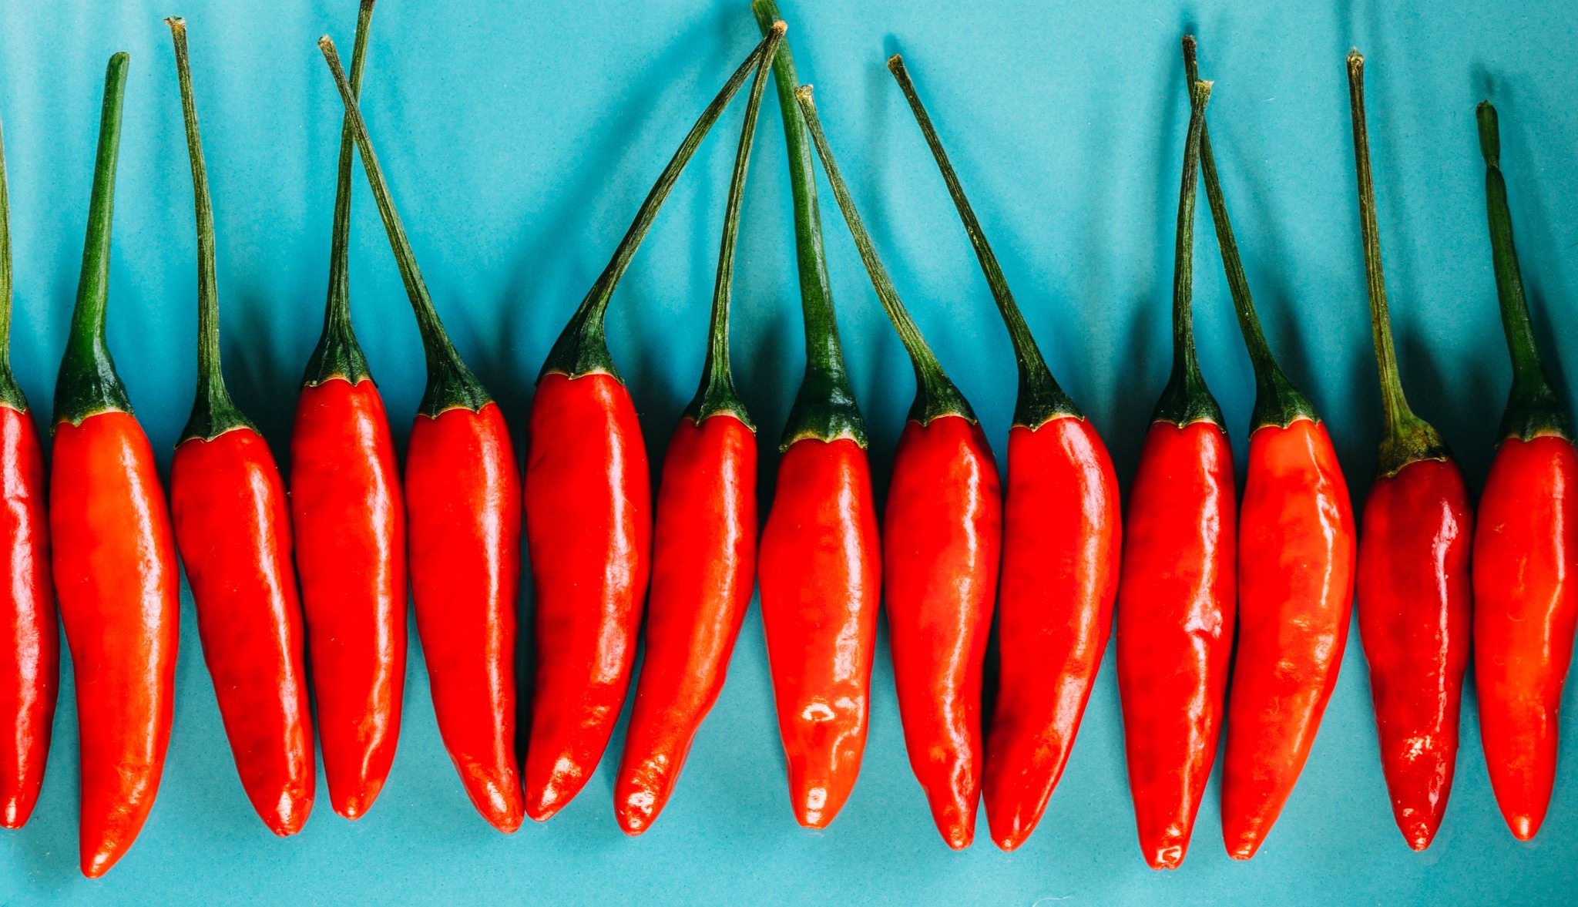

Spicy is GOOD
Exploring Mexican restaurants

Slide 2
What will we do?
Explore food establishments using the Yelp Open Dataset to answer questions regarding how they are ranked.
Focus on Mexican food establishments.
Using star rating and user reviews.
We will also use a Zillow price index (Median List Price for All Homes) to further analyze the restaurants.

Slide 3
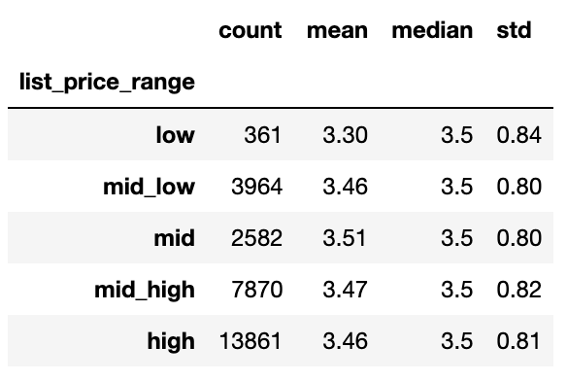

Are restaurants in expensive cities better rated?
Notes:
We used the Zillow dataset to divide cities in 5 buckets depending on the price level for All homes.
Then we merged it with the Yelp dataset to only use the cities that appear on both databases.
Results show that there doesn’t appear to be much difference in the rating, except for cities in the low list price range.
The same analysis was then used for only mexican restaurants and results were similar, but with a higher dip in the low list price range (small sample size?)

Slide 4
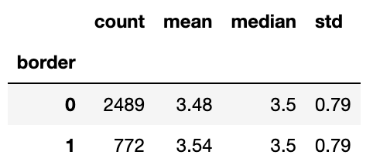
Do mexian restaruants in border states fare better?
Notes:
So price level of homes don’t have an effect on star rating.
For mexican restaurants, what about if the locale is located in a border state (California, New Mexico, Arizona and Texas).
Being in the border accounts for a increase in star rating of 0.06.
Being in the border appears to have a marginal effect on rating then, reasons?

Slide 5
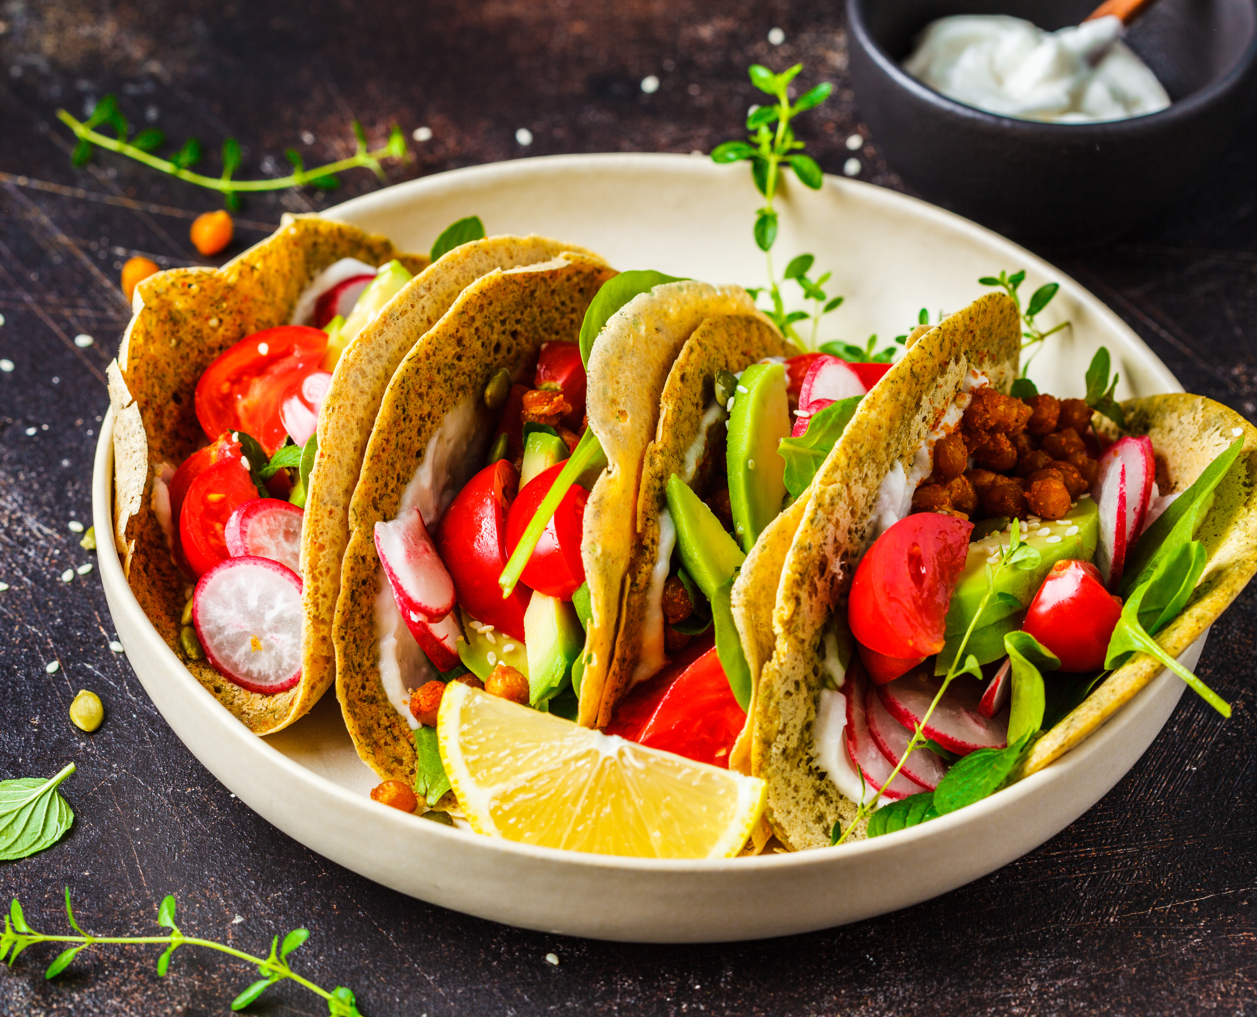
Is being reviewed as a SPICY restaurant good for your rating?
User Review Example:
'Chips and salsa were good but you had to pay for them including salsa picante which was perfectly spicy. Food was tasty and margaritas were refreshing. I had the tacos and were pretty good.'
Notes:
Mexican food is famous for being spicy
Is there a way to analyze the user review text of a restaurant, see if they talk about Spiciness and see if it correlates with star rating?
Using synonyms of Spicy like: Spice, picante, fuego, caliente
The above example has 2 spicy words: picante and spicy.

Slide 6
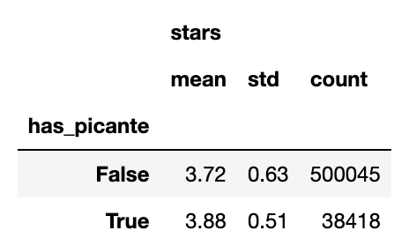
If the review has a PICANTE word or not
Notes:
If the review does not uses any spicy words then the star rating is 0.16 stars lower than if it does, also it’s standard deviation increases.
But is that statiscally significant? Yes, a t-test was conducted and the variable is statistically significant.
Then, what happens when a spicy word is used more than once? Could it be that if it is used too much it is probably a complaint?

Slide 7
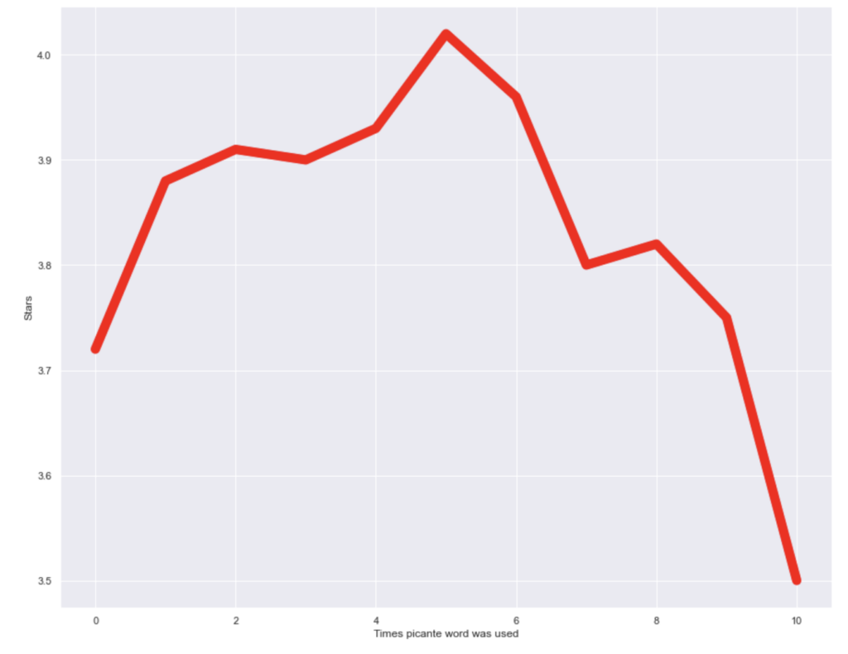
How spicy is too spicy?
There appears to be a happy medium. Not to bland and not to hot.
Notes:
- Mexican restaruants that were reviewed with 0 usages of a spicy word have a lower rating than those that used it a bit, up to 8 and 9 times.
The sweet spot is around 5 times, that’s when restaurants ratings went above 4.0 stars on average.
There’s a big drop when a word like these was used 10 times or more. Those clients probably needed some Horchata water to calm down their burning tounges.

Slide 8
Conclusions
Neither being in an expensive city or in a border state one has an effect on star rating. Mexican food is equally good across our database cities.
What does affect rating is if your food is percieved as spicy!
No shock, people want good salsa.
There’s a sweet spot in how spicy the reviews are. If you are a restaurant owner, don’t overdo it!
Chilli peppers contain more vitamin C than oranges; so go out, have a taco and bite on that Jalapeño.

